Slide 1
Local-Alignment
Derek Parkinson Ellie Ungar
Torgeir Kjoeita Ali Khan
Rick Djeuhon Seth Barker
Carly Good

Slide 2
Group roles
Project Manager: Torgeir Kjoeita
Researcher: Derek Parkinson
Quality Assurance Specialist: Rick Djeuhon
Developer: Carly Good
Developer: Ali Yar Khan
Technical Writer: Ellie Ungar
GUI Developer: Seth Barker

Slide 3
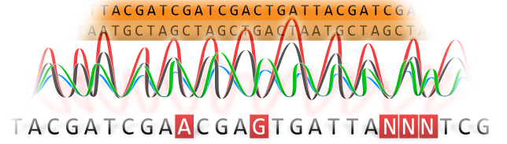
Motivation
Overall, our challenge was to create a piece of software that biologists can use to match DNA, RNA, and protein sequences.

Slide 4
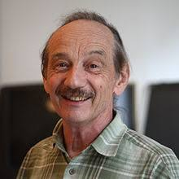

History
Proposed in 1981 by professors Temple F. Smith and Michael Waterman
Uses dynamic programming for their algorithm
Based on its global opposite Needleman-Wunsch algorithm
Calculates local alignment

Slide 5
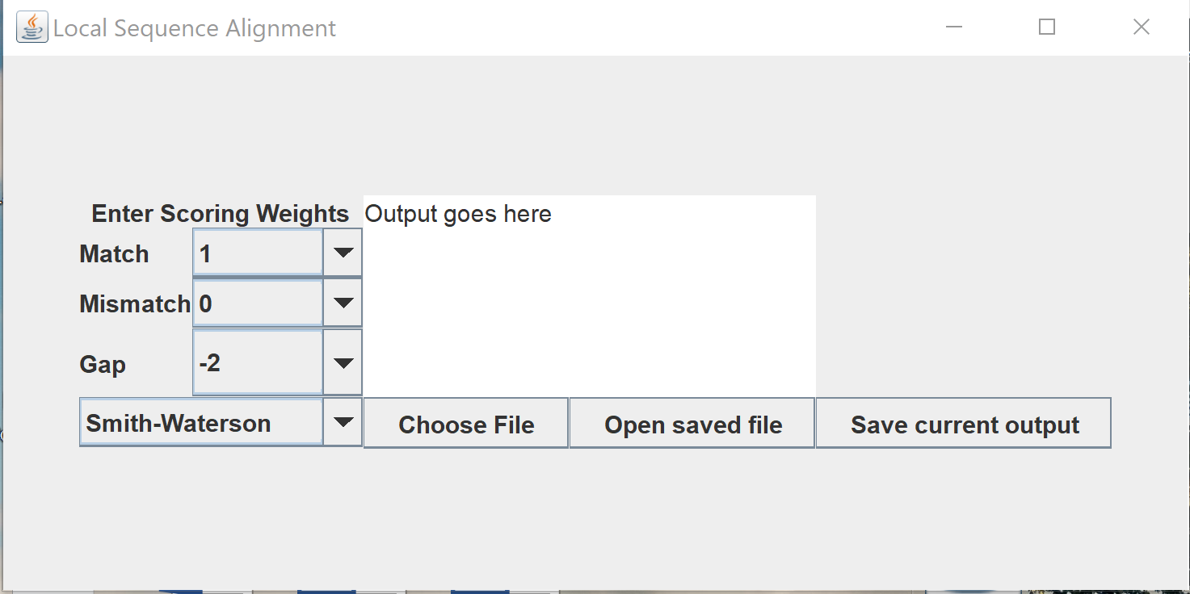
How to use the program: the user interface

Slide 6
Smith-Waterman
Purpose: calculates the local alignment of two given sequences
Output: optimal local alignment considering the given scoring system
Features:
-Consists of a substitution matrix and a gap-scoring scheme.
-Scores include matches, mismatches, substitutions or insertions/deletions
-Cannot display any negative scores in its scoring matrix and will set any of them to zero
Advantages and Disadvantages:
- Time complexity and space complexity is O(mn)
-Promises accuracy in results

Slide 7
Other Algorithms
-Brute Force
-Greedy
-Divide and Conquer

Slide 8
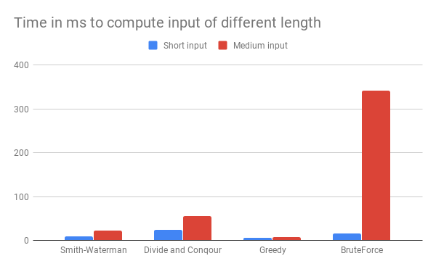
Analysis
Notes:
Large input was tested but not included in the graph as the scale get messed up. The trend is the same as with those inputs, except that brute force runs out of memory.

Slide 9
More on the website
https://ellie-ungar.github.io/Local-Alignment-Group/

Slide 10
References
[1] Norman Casagrande, Basic-Algorithms of Bioinformatics Applet, http://baba.sourceforge.net/, 2003.
[2] Freiburg RNA Tools. Teaching Smith-Waterman.
[3] Jacob Porter, Jonathan Berkhahn, Liqing Zhang. A Comparitive Analysis of Read Mapping and Indel Calling Pipelines for Next-Generation Sequencing Data. In Emerging Trend in Computational Biology, Bioinformatics, and Systems Biology. 2015, pages 521-535.
[4] Supratim Choudhuri. Sequence Alignment and Similarity Searching in Genomic Databases. In Bioinformatics for Beginners. 2014, pages 133-135.
[5] Julie Dawn Thompson. Heuristic Sequence Alignment Methods. In Statistics for Bioinformatics. 2016, pages 29-41.

